Slide 1
機器學習應用於信用卡詐欺的績效評估
Performance evaluation of machine learning applications detecting credit card fraud
312707033包坤達、313707048郭奕伶
20240419 TEN MFS.key

Slide 2
Motivation
Data
Design of analysis
Empirucal results
Conclusion
IDA Template

Slide 3
Movitation

Slide 4
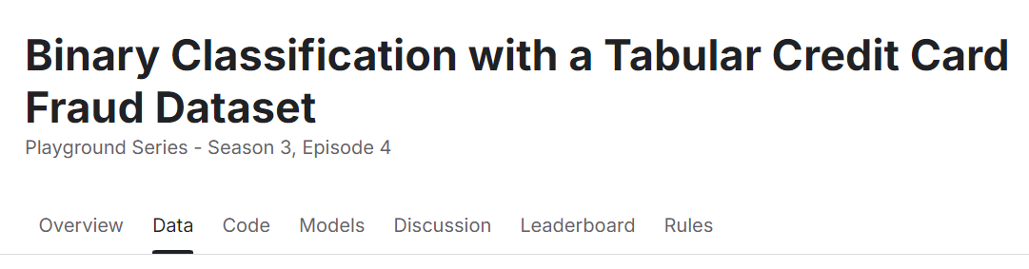
Motivation
Motivation
Credit card fraud detection is a challenging and typical binary classification problem that involves handling highly imbalanced data.
Researching this problem helps demonstrate the potential of machine learning algorithms in the financial sector, particularly in improving model performance and addressing data imbalance issues.
IDA Template

Slide 5
Data

Slide 6
Data

Slide 7
Design of analysis

Slide 8
Motivation
How to do
Model used:Decision tree,RandomForest,XGBoost
Model | Advantages
Decision tree | Ability to handle imbalanced data Easy to interpret
RandomForest | Anti-overfitting Training well for high-dimensional data
XGBoost | High accuracy Fast computation Ability to handle imbalanced data
IDA Template

Slide 9
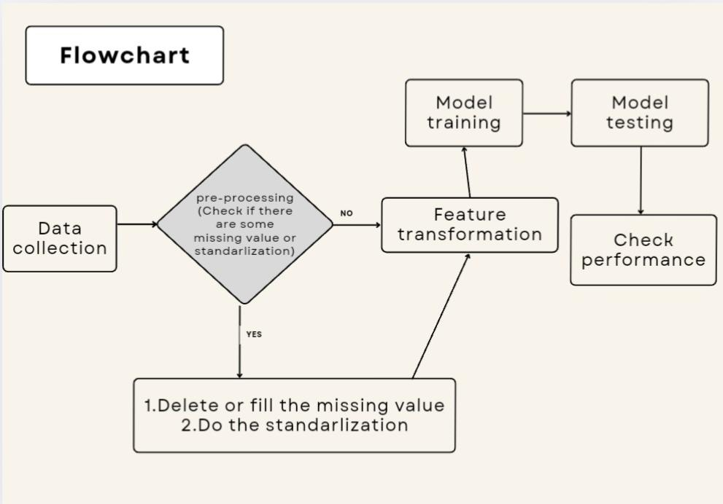

Slide 10
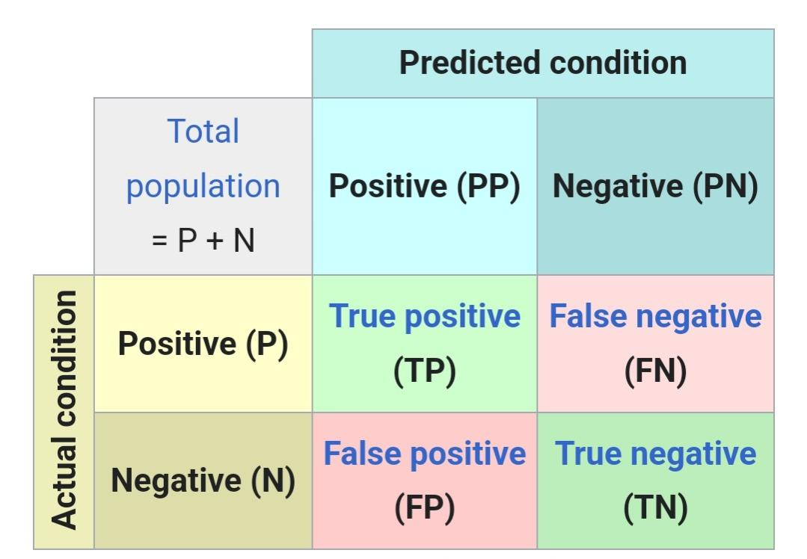
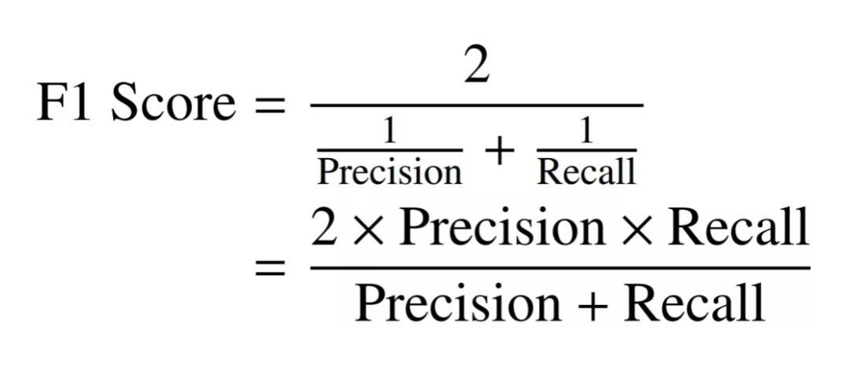
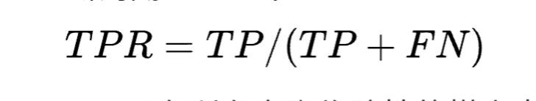
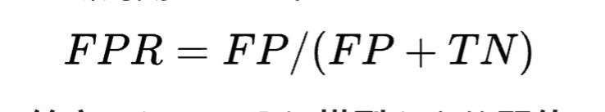
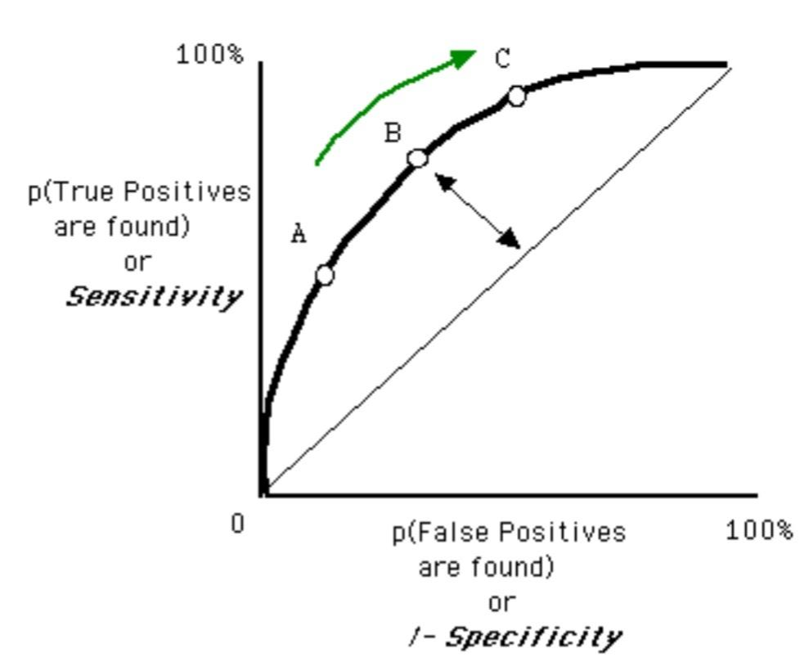
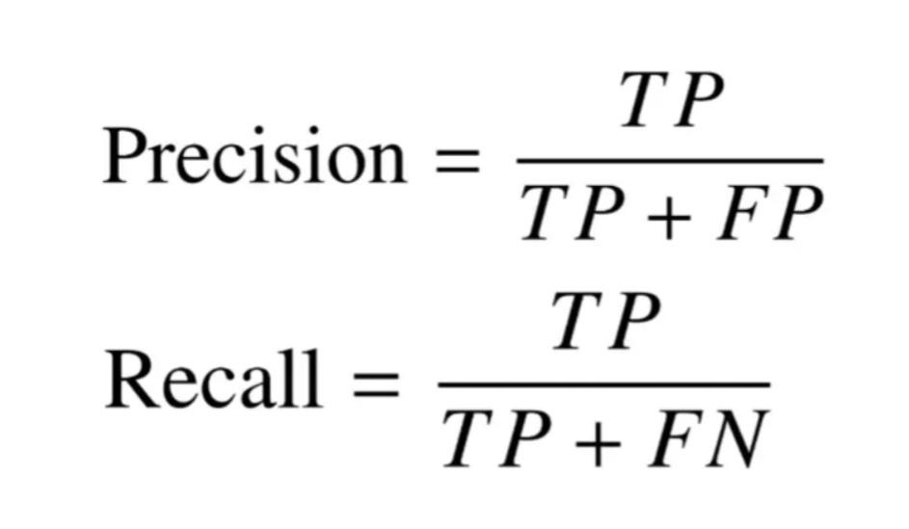
Performance
1.Confusion matrix. 2.F1-score. 3.AUC/ROC curve

Slide 11
TEN Template
Repeat on last slide the lead picture

